Slide 1
Design & development of digital hydraulic valve system in a hydrostatic system
By:
Muskan [20JE0593]
Prashant Singh [20JE0712]
T Sharath Chandrahas Reddy [20JE1011]
Supervisor:
Prof. Jayanta Das
Mining Machinery Engineering
Department of Mechanical Engineering

Slide 2
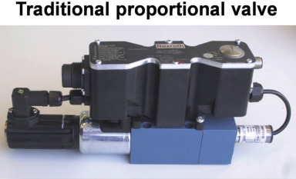
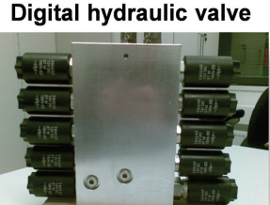
Introduction
The current hydraulic systems uses expensive proportional DCVs.
Proportional DCVs are high maintenance which leads to high operational costs.
Goal: Substituting conventional proportional DCVs with multiple cost-effective digital binary shut-off valves.
Range of operation can be varied based on number of valves we open at a given instant.
2

Slide 3
Drawbacks of Conventional Proportional Valve
Proportional valves are expensive due to their intricate design.
Proportional valves are susceptible to wear and tear, requiring frequent maintenance.
Proportional valve maintenance requires specialized knowledge and skills.
Proportional valve requires a continuously running pump to combat leakage and flow losses.
Proportional valve can be less energy-efficient due to hydraulic losses, especially when operating at partial flow or pressure conditions.
Traditional proportional valves may have slower response times compared to newer digital valves
3

Slide 4
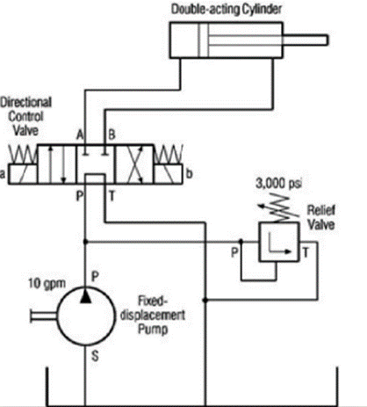
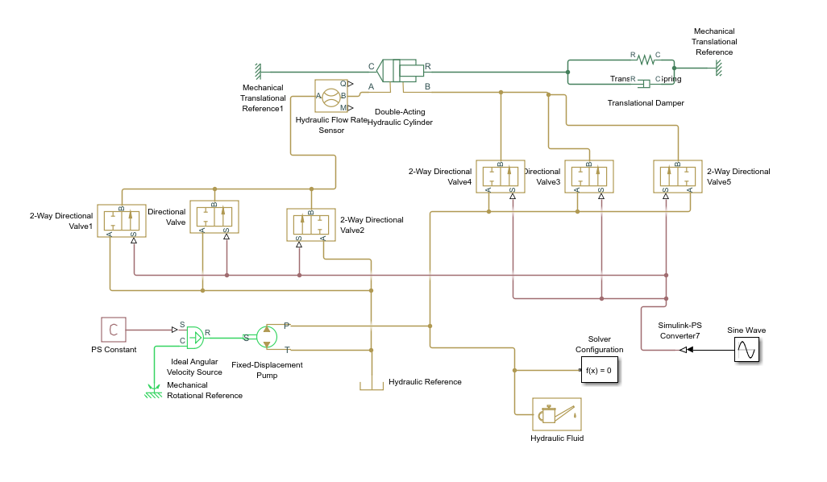
Set-Up details
4
Fig. 1. Hydraulic circuit with a conventional proportional DCV
Fig. 2. Hydraulic circuit with digital valves in place of conventional proportional valve

Slide 5
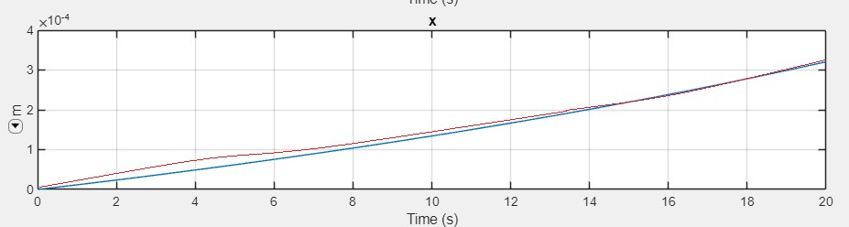
Replacement of conventional proportional valve with digital valves
By varying the opening time with the help of look-up tables, we can change the overall signal given to the system.
CASE 1 (test for leakage flow when no inlet valve is open)
Proportional valve
Digital valve
5
Fig. 3.

Slide 6
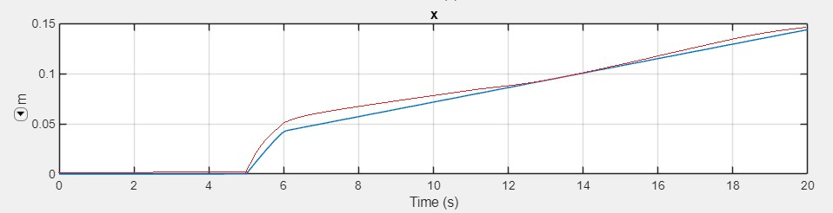
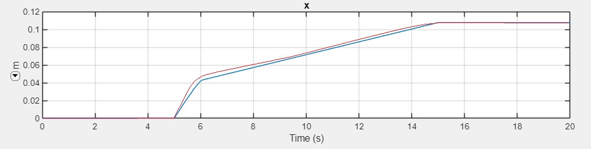
CASE 2
CASE 3
6
Inlet Valve | Inlet Valves Opening TIme (s) | Return Valve | Return Valves Closing Time (s)
Valve 1 | 5 s | Valve 4 | remains open
Valve 2 | 10 s | Valve 5 | remains open
Valve 3 | 15 s | Valve 6 | remains open
Inlet Valve | Inlet Valves Opening TIme (s) | Return Valve | Return Valves Closing Time (s)
Valve 1 | 5 s | Valve 4 | 5 s
Valve 2 | 10 s | Valve 5 | 10 s
Valve 3 | 15 s | Valve 6 | 15 s
Fig. 4.
Fig. 5.
Proportional valve
Proportional valve
Digital valve
Digital valve
By controlling both the opening and the closing time of the working valves and the return valves, respectively, we can see similar displacement characteristics compared to conventional proportional DCV.

Slide 7
CONCLUSION
Discussion
In this setup, we are manually controlling the opening/closing time of individual valves, which is time-consuming and impractical for large-scale applications.
It requires constant human intervention and doesn't allow for precision and dynamic adjustments.
A PID or other advanced controllers can efficiently manage multiple valves and actuators simultaneously and adapt to changing conditions, making it suitable for large-scale industrial applications.
7

Slide 8
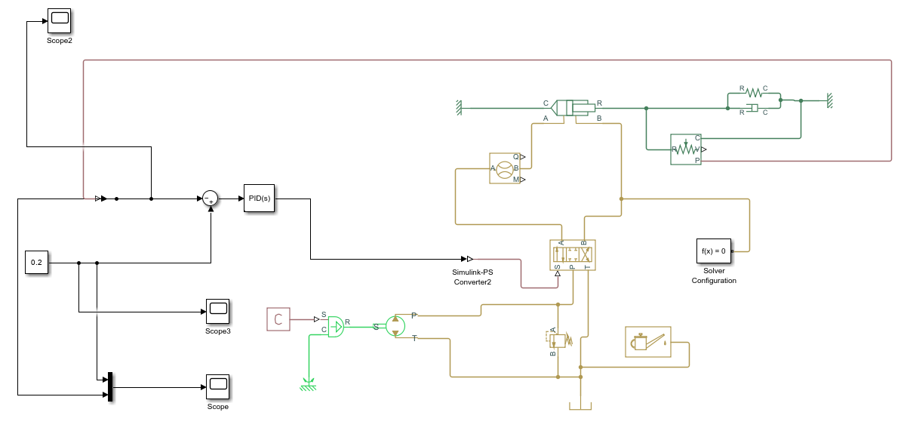
Circuit with a conventional proportional DCV valve controlled by a PID controller
8
Fig. 6.

Slide 9
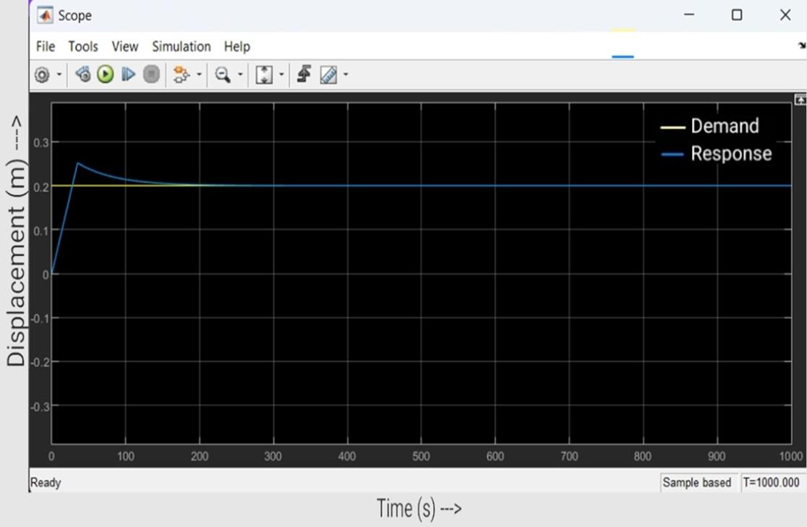
9
Fig. 7.
Discussion
Maintaining a constant and precise displacement of an actuator is crucial in various industrial applications.
A PID controller is a feedback control system that is commonly used to regulate processes and maintain desired setpoints.
A PID controller plays a crucial role in achieving and maintaining a constant displacement by actively responding to errors and deviations, ultimately stabilizing the system after the initial overshoot and providing the desired level of precision and control in various industrial applications.

Slide 10
10
Digital valve control using S-function
Previous method: Individual valve control, tedious and cumbersome.
Transition: Utilizing S-function in Simulink for intelligent control.
S-function: Integrates custom code, acts as automated control module.
Functionality: Receives single demand value, calculates opening/closing signals for all valves.
Benefits: Eliminates manual control, streamlines process, enhances scalability.
Implementation: Utilizing "level-2 S-function" feature in Matlab Simulink.

Slide 11
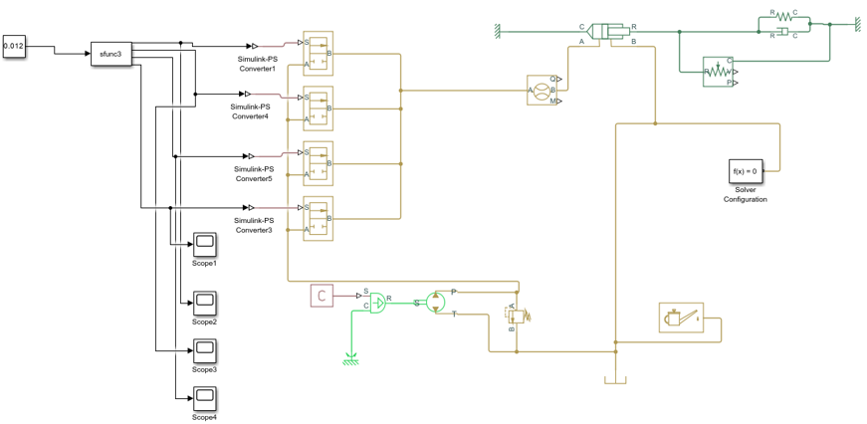
11
Fig. 8. Circuit containing 4 digital valves and level 2 S-function
Input to S-function | Output to Valves
input<0.006 | Valve 1: 0. Valve 2: 0, Valve 3: 0, Valve 4:0
0.006 <= input < 0.012 | Valve 1: 1. Valve 2: 0, Valve 3: 0, Valve 4:0
0.012 <= input < 0.018 | Valve 1: 1. Valve 2: 1, Valve 3: 0, Valve 4:0
0.018 <= input <0.024 | Valve 1: 1. Valve 2: 1, Valve 3: 1, Valve 4:0
input>=0.024 | Valve 1: 1. Valve 2: 1, Valve 3: 1, Valve 4:1
Fig. 9. Opening and closing statuses of all 4 valves at a given demand

Slide 12
12
Digital valve control with S-function and PID
S-functions limitations:
Debugging Challenges: Isolating errors within custom code is time-consuming.
Performance Overhead: Complexity of S-function code may lead to computational overhead.
Combining S-functions with PID control:
Strengths:
S-functions: Flexibility for complex control logic specific to digital hydraulic system.
PID control: Refinement of system response by continuously monitoring error and adjusting valve opening sequences.
Benefits:
S-functions handle core logic of translating demand values into valve sequences.
PID control mitigates issues like overshoot or settling time.

Slide 13
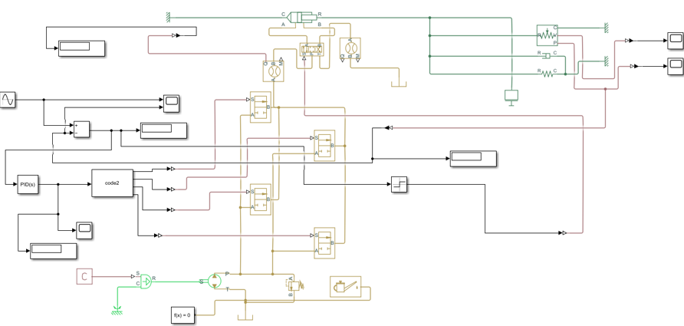
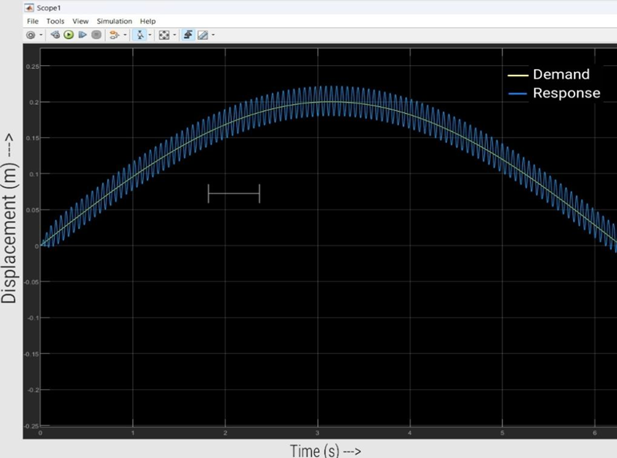
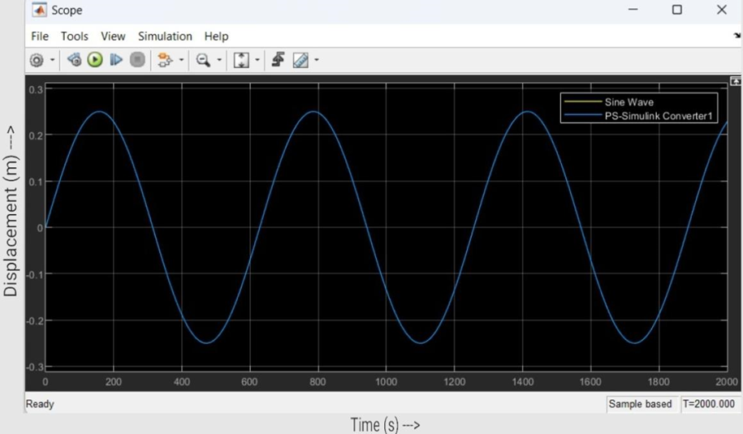
13
Fig. 10. Hydraulic circuit containing level 2 S-function, PID 4 digital valves
Fig. 11. Displacement v/s time demand (yellow curve) v/s response (blue curve) in case of S-function and PID control of digital valves
Fig. 12.. Displacement v/s time graph (yellow curve for demand; blue curve for response) in case of conventional DCV with PID control

Slide 14
Conclusion | Future Works
Replaced conventional DCV with digital valves(binary in operation) for increased range, cost-effectiveness, and ease of maintenance. Integrated PID controller with DCV for autonomous control without human intervention. Used s-function in digital hydraulic circuit to automate the opening and closing of valves. Integrated both PID controller and s-function in digital hydraulic circuit to further reduce errors. | There is a need to optimize the number of digital valves we can use as bulkiness of system increases with increase in valves. As this is a simulation, further we can develop an experimental setup. Use of advanced controllers like MPC and FLC instead of PID.
14

Slide 15
References
1. Krus P, Pieri E, Teixeira P and Locateli C, 2014. Digital Hydraulic System Using Pumps and On/Off Valves Controlling the Actuator. 2. Raghuraman D.R.S., Senthil S.K., 2016. Digital hydraulic valves - a brief review. 3. Bao R, Wang T, 2019. A Multi-Pump Multi-Actuator Hydraulic System with On-Off Valve Matrix for Energy Saving. 4. De Negri, V. J., Wang, P., Johnson, D. N. , Plummer, A., 2014. Behavioural prediction of hydraulic step -up switching converters. International Journal of Fluid Power. Vol 15, No. 1, pp. 1 - 9 . 5. Linjama, M., Vilenius, M., 2005. Energy-efficient motion control of a digital hydraulic joint actuator. Proceedings of the 6th JFPS International Symposium on Fluid Power. Tsukuba, November 7 - 10. 6. Eggers, B., Rahmfeld, R., Ivantysynova, M., 2005. An energetic comparison between valveless and valve-controlled active vibration damping for off-road vehicles. Proceedings of the 6th JFPS International Symposium on Fluid Power. Tsukuba. 7. Willkomm, J., Wanler, M. & Weber., J., 2014. Process-adapted control to maximize dynamics of displacement-variable pumps. Symposium on Fluid Power & Motion Control. Bath, United Kingdom. pp. 10-12. 8. Teixeira, P. L., Vianna, W., Penteado, R. D., Krus, P. & De Negri., V. J., 2015. Pressure modeling and analysis of a synchronized hydraulic press brake with variable-speed pump. Symposium on Fluid Power and Motion Control. Chicago, Illinois, USA. 9. Linjama, M., Laamanen, A. , Vilenius, M. , 2003. Is it time for digital hydraulics? The Eighth Scandinavian International Conference on Fluid Power, May 7 –9, Tampere, Finland, pp. 347 –366. 10. Belan, H, B., Locateli, C. C., Endler, L., Pieri, E. R. D. & De Negri, V.J., 2014. Aumento da eficiência energética em sistemas hidráulicos utilizando hidráulica digital. XX Congresso Brasileiro de Automática, Belo Horizonte, Brazil, 20 - 24 Sept. 11. Belan, H. B., Locateli, C. C., Lantto, B., Krus. P. & De Negri, V. J., 2015. Digital secondary control architecture for aircraft application. The Seventh Workshop on Digital Fluid Power, February 26 -27, Linz, Austria. 12. Linjama, M., Vilenius, M., 2008. Digital hydraulics – Towards perfect valve technology. Technology. Digitalna Hidravlika, Ventil 14. 2. pp. 138-148. 13. Scheidl, R.; Kogler, H.; Winkler, B., 2013. Hydraulic switching control - Objectives, concepts, challenges, and potential applications. Magazine of Hydraulics, Pneumatics, Tribology, Ecology, Sensorics, Mechatronics, n. 1, ISSN: 1453 - 7303.
15

